Slide 1
Visualization of the dependence of the occurrence of oncological diseases on the level of development of the country due to CO2 emissions
Rystin Asset
Toleutay Aldiyar
Zhakipbayev Almas

Slide 2
Why this is important?
In the current technogenic world, the problem of ecology is closely related to the life of people, specifically with health and the emergence of new diseases. Today we can compare the level of development of countries by such a key indicator as GDP, thereby saying that this is an indirect indicator of a well-functioning manufactory.
However, the excess of some production has been and will continue to be carbon dioxide (CO2) pollution, which is a carcinogen that can cause cancer.
The relevance of the topic is to identify the appearance of cancer in the future by predicting future CO2 emissions and visualizing them. This visualization will help to prevent the appearance of oncological diseases.

Slide 3

Research hypothesis
Residents of cities where there are factories that pollute the atmosphere with CO2 suffer from cancer more often than residents of cities where there are no such plants.
H1
If the country's GDP indicator decreases, the indicator of carbon dioxide (CO2) pollution will decrease
H2

Slide 4
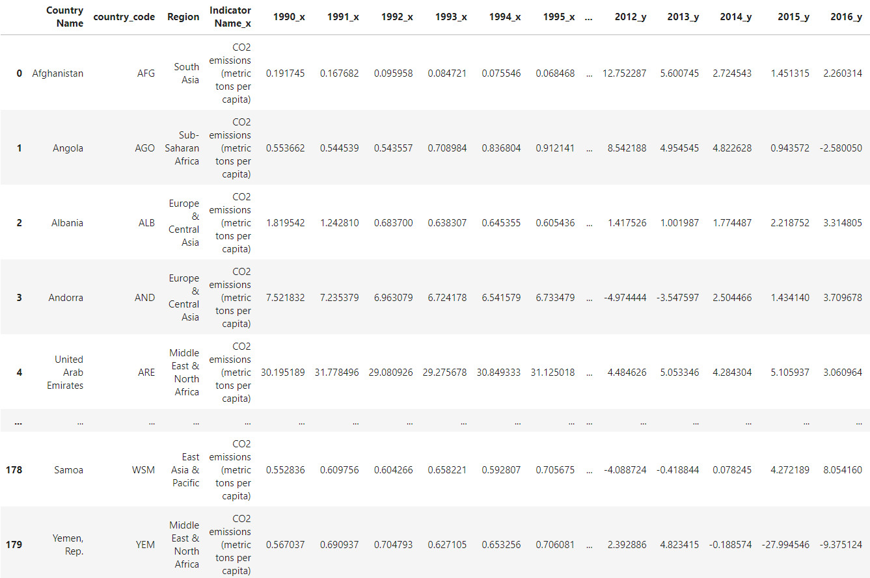
Chosen Datasets
GPD
CO2 emissions
Total cancer deaths by type

Slide 5
Thank you for your attention!

